Slide 1

Nataliia
Proskurnycha
.NET developer
@ Binary Studio

Slide 2
RxJS

Slide 3
WHAT DOES REACTIVITY MEAN?

Slide 4
Reactive programming
Reactive programming is a declarative programming paradigm concerned with data streams and the propagation of change. (Examples: Excel Table, two-way binding)
a = 1; b = a + 1; a = 2; console.log(a); // --> 2 console.log(b); // --> 2
a = 1; b = a + 1; a = 2; console.log(a); // --> 2 console.log(b); // --> 3

Slide 5
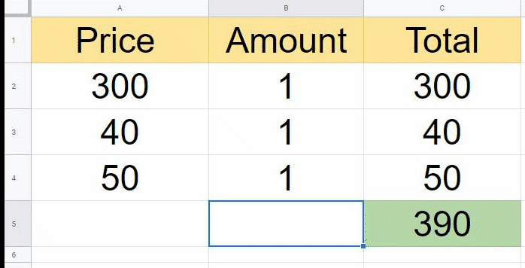
Reactive programming
Reactive programming is a declarative programming paradigm concerned with data streams and the propagation of change. (Examples: Excel Table, two-way binding)

Slide 6
Reactive systems are
1. Responsive
2. Resilient
3. Elastic
4. Message-driven

Slide 7
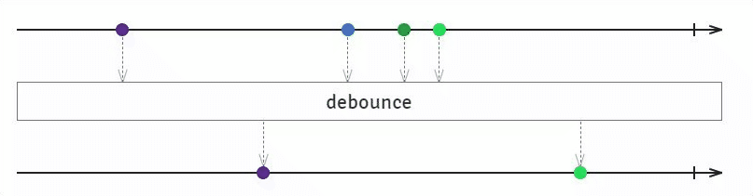
Reactive programming
Observable emits data
Observer receive them

Slide 8
HISTORY

Slide 9
ReactiveX
Languages
Microsoft, a computer scientist named Erik Meijer created a reactive programming framework for .NET called Reactive Extensions. In a matter of years, Reactive Extensions (also called ReactiveX or Rx) was ported to several languages and platforms, including JavaScript, Python, C++, Swift, and Java, of course. ReactiveX quickly emerged as a cross-language standard to bring reactive programming into the industry.
Java: RxJava
JavaScript: RxJS
C#: Rx.NET
C#(Unity): UniRx
Scala: RxScala
Clojure: RxClojure
C++: RxCpp
Lua: RxLua
Python: RxPY
Go: RxGo
Groovy: RxGroovy
JRuby: RxJRuby
Kotlin: RxKotlin
Swift: RxSwift
PHP: RxPHP
Elixir: reaxive
Dart: RxDart
Ruby: Rx.rb
Check site

Slide 10
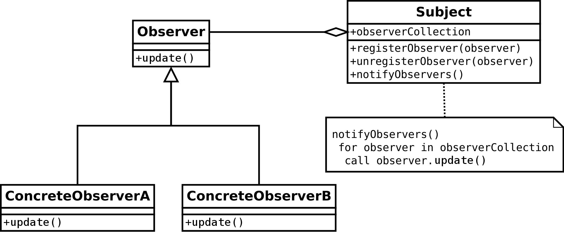
Observer pattern

Slide 11
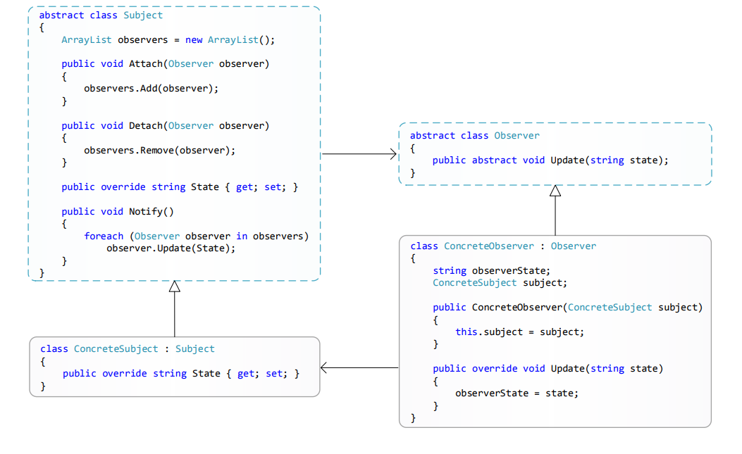
Observer pattern

Slide 12
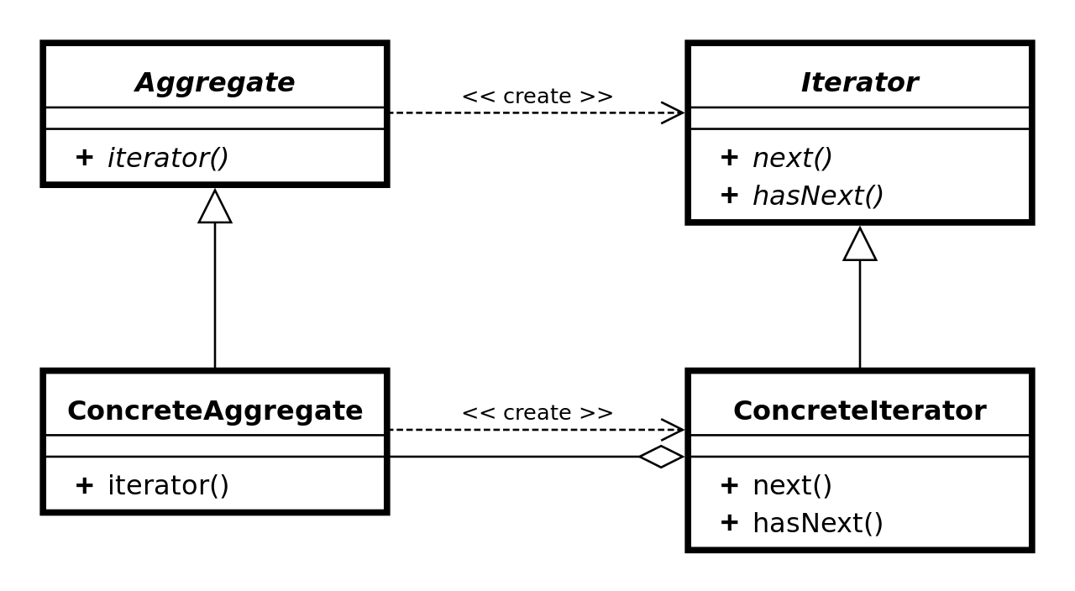
Iterator pattern

Slide 13

ReactiveX
ReactiveX is a library for composing asynchronous and event-based programs by using observable sequences.
It extends the observer pattern
Observables fill the gap by being the ideal way to access asynchronous sequences of multiple items
ReactiveX is a combination of the best ideas from
the Observer pattern, the Iterator pattern, and functional programming

Slide 14
WHY ARE PROMISES NOT ENOUGH?

Slide 15
Promise
A Promise is an object that is used as a placeholder for the eventual results of a deferred (and possibly asynchronous) computation.
Promises are most commonly used to handle HTTP requests.
Make a request and then wait for a single response. You can be sure that there won’t be multiple responses to the same request.
const p1= new Promise((resolve) => {
resolve(5);
});
p1.then(value => console.log(value));
// will simply print 5
const p2 = new Promise((resolve) => {
resolve(5);
resolve(10);
});
p2.then(value => console.log(value));
// still prints only 5

Slide 16
Promise Objects
Single request — single response model only works with simple HTTP requests or setTimeout calls. But there are still:
setInterval calls;
webSockets;
DOM events (mouse clicks etc.).

Slide 17

Observables!
const numberObservable = new Observable((observer) => {
observer.next(5);
observer.next(10);
});
numberObservable.subscribe(value => console.log(value));
// will print 5 and 10

Slide 18
OBSERVABLE

Slide 19
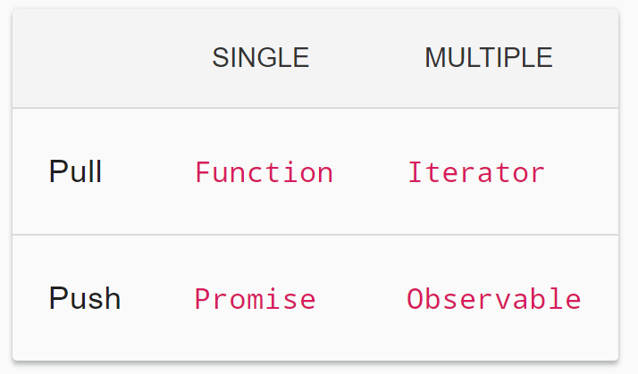
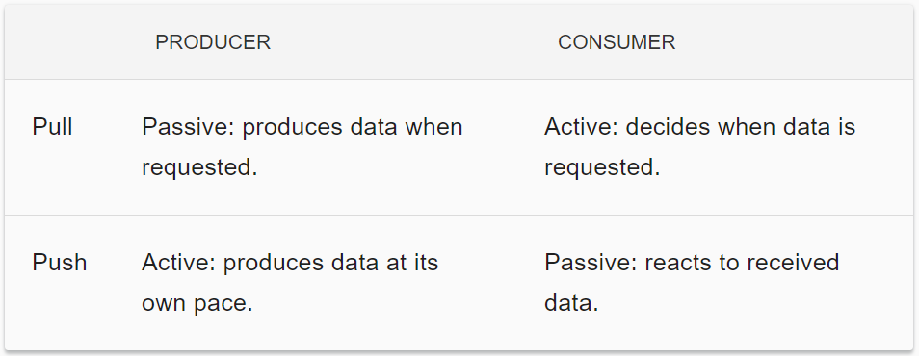
Observable
A Function is a lazily evaluated computation that synchronously returns a single value on invocation.
A Generator is a lazily evaluated computation that synchronously returns zero to (potentially) infinite values on iteration.
A Promise is a computation that may (or may not) eventually return a single value.
An Observable is a lazily evaluated computation that can synchronously or asynchronously return zero to infinite values from the time it's invoked onwards.

Slide 20
Anatomy of an Observable
Creating Observables const observable = new Observable(function subscribe(subscriber) { subscriber.next('hi'); });
Subscribing to Observables const subscription = observable.subscribe(x => console.log(x));
Executing the Observable next*(error|complete)?
Disposing Observables subscription.unsubscribe();

Slide 21

Promise vs Observable
a Promise can provide a single value, whereas an Observable is a stream of values (from 0 to multiple values);
a Promise is eager, whereas an Observable is lazy;
let myFirstPromise = new Promise((resolve, reject) => {
console.log("Hello!")
resolve("42");
})
myFirstPromise.then((data) => {
console.log(data)
});
myFirstPromise.then((data) => {
console.log(data)
}); See more...

Slide 22
Promise vs Observable
Promise is always asynchronous, while an Observable can be either synchronous or asynchronous,
You can apply RxJS operators to an Observable to get a new tailored stream.
Promise.resolve().then(function callbackA () {
console.log("finish A");
}).then(function callbackB () {
console.log("finish B");
});
Promise.resolve().then(function callbackC () {
console.log("finish C");
}) See more

Slide 23
Did I meet you earlier?
const observable = new Observable(subscriber => {
subscriber.next(1);
subscriber.next(2);
subscriber.next(3);
setTimeout(() => {
subscriber.next(4);
subscriber.complete();
}, 1000);
});
console.log('just before subscribe');
observable.subscribe({
next(x) { console.log('got value ' + x); },
error(err) { console.error('something wrong occurred: ' + err); },
complete() { console.log('done'); }
});
console.log('just after subscribe');

Slide 24
private class Subject : IObservable<int> { public IDisposable Subscribe(IObserver<int> observer) { throw new NotImplementedException(); } } private class Observer : IObserver<int> { public void OnCompleted() { throw new NotImplementedException(); } public void OnError(Exception error) { throw new NotImplementedException(); } public void OnNext(int value) { throw new NotImplementedException(); } }

Slide 25
OPERATORS

Slide 26
What are operators?
Operators are functions!
PIPEABLE
CREATION
Takes an Observable as its input and returns another Observable;
It is a pure operation;
Examples: filter(...), mergeMap(...);
Standalone functions to create a new Observable;
Examples: of(1, 2, 3), interval(1000);

Slide 27
Piping
operator()(observable) { … }
op4()(op3()(op2()(op1()(obs))))
obs.pipe(
op1(),
op2(),
op3(),
op3(),
)

Slide 28
Categories of operators
Creation
2. Join Creation
of(1, 2, 3)
from([1, 2, 3])
range(1, 10)
interval(1000)
fromEvent(document, ‘click’)
throwError
forkJoin
merge
combineLatest
concat

Slide 29
Categories of operators
3. Filtering
4. Error Handling
filter
first/last
take
skipUntil
distinct
catchError
retry
retryWhen

Slide 30
https://stackblitz.com/edit/rxjs-yeawkw

Slide 31
Higher-order Observables
Observables most commonly emit ordinary values like strings and numbers, but surprisingly often, it is necessary to handle Observables of Observables, so-called higher-order Observables.
const fileObservable = urlObservable.pipe(
map(url => http.get(url)),
);
But how do you work with a higher-order Observable? Typically, by flattening (join)
const fileObservable = urlObservable.pipe(
map(url => http.get(url)),
concatAll(),
);

Slide 32
Categories of operators
5. Transformation
6. Join
map
concatMap
switchMap
mergeMap
buffer
groupBy
combineAll
concatAll
mergeAll
withLatestFrom
exhaust

Slide 33
Categories of operators
5. Multicasting
6. Utility
7. Conditional and Boolean
8. Mathematical and Aggregate
multicast
publish
publishLast
tap
delay
timeout
toArray
every
find
findIndex
isEmpty
count
min/max
reduce

Slide 34

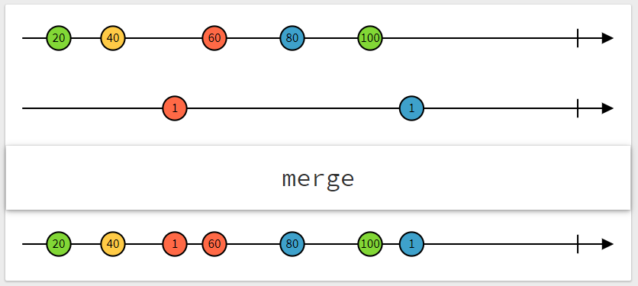
Categories of operators
https://rxmarbles.com/

Slide 35
SUBJECTS

Slide 36
What is the Subject?
An RxJS Subject is a special type of Observable that allows values to be multicasted to many Observers;
While plain Observables are unicast, Subjects are multicast;
Every Subject is an Observer

Slide 37
What is the Subject?
Subject is an object with the methods next(v), error(e), complete
const subject = new Subject<number>();
// observerA
subject.subscribe({
next: (v) => … ,
error: (e) => … ,
complete: (v) => …
});
// observerB
subject.subscribe({
next: (v) => ...
});
subject.next(1); https://stackblitz.com/edit/rxjs-fymoyn

Slide 38

Types of Subject
BEHAVIOR
REPLAY
ASYNC
notion of "the current value";
useful for representing "values over time";
A ReplaySubject is similar to a BehaviorSubject in that it can send the exact amount of old values to new subscribers;
new ReplaySubject(3);
Only the last value of the Observable execution is sent to its observers;
Only when the execution completes;

Slide 39
Story of one programmer
const subject = new BehaviorSubject(0);
subject.subscribe({
next: (v) => console.log(`Programmer: ${v}`)
});
subject.next(1000$); // you received your first invoice
subject.next(10$); // you celebrated really well
subject.next(210$); // you loaned money from your colleague
subject.next(1210$); // you received your second invoice
subject.subscribe({ // your Mom decided to know how are you doing
next: (v) => console.log(`Mom: ${v}`)
});

Slide 40
Story of one programmer
const subject = new ReplaySubject(3);
subject.subscribe({
next: (v) => console.log(`Programmer: ${v}`)
});
subject.next(1000$); // you received your first invoice
subject.next(10$); // you celebrated really well
subject.next(210$); // you loaned money from your colleague
subject.next(1210$); // you received your second invoice
subject.subscribe({ // your Mom decided to know how are you doing
next: (v) => console.log(`Mom: ${v}`)
});

Slide 41
Story of one programmer
const subject = new AsyncSubject();
….
subject.next(1210$); // you received your second invoice
subject.subscribe({ // your Mom decided to know how are you doing
next: (v) => console.log(`Mom: ${v}`)
});
subject.next(1010$); //you repaid a debt
subject.complete();//day expiration of your card

Slide 42
DEMO

Slide 43
Demo
https://stackblitz.com/edit/rxjs-3swwoy

Slide 44
CORNER CASES

Slide 45

Corner Cases
Promises are promises, observables are observables, both are awesome abilities of languages, use them smart
Don’t forget unsubscribe
Be aware of how operators work cause it can be tricky

Slide 46
SUMMARY

Slide 47




Summary
Functional Avoid intricate stateful programs, using clean input/output functions over observable streams. Less is more ReactiveX's operators often reduce what was once an elaborate challenge into a few lines of code. Async error handling Traditional try/catch is powerless for errors in asynchronous computations, but ReactiveX is equipped with proper mechanisms for handling errors. Concurrency made easy Observables and Schedulers in ReactiveX allow the programmer to abstract away low-level threading, synchronization, and concurrency issues.

Slide 48
Resources
http://reactivex.io/
http://reactivex.io/tutorials.html
https://rxmarbles.com/
https://www.learnrxjs.io/operators/utility/finalize.html
https://rxjs-dev.firebaseapp.com/guide/overview

Slide 49

THANK YOU!

